Slide 1
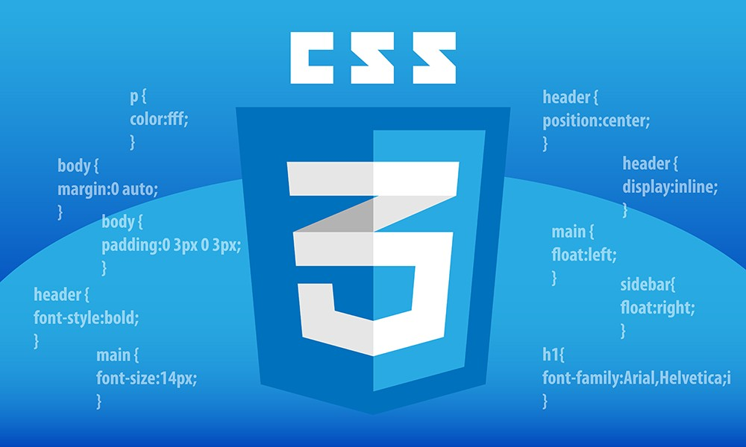
So…what exactly is

Slide 2

Basically, it changes how your HTML Presents itself
Think of it as make-up for your HTML

Slide 3
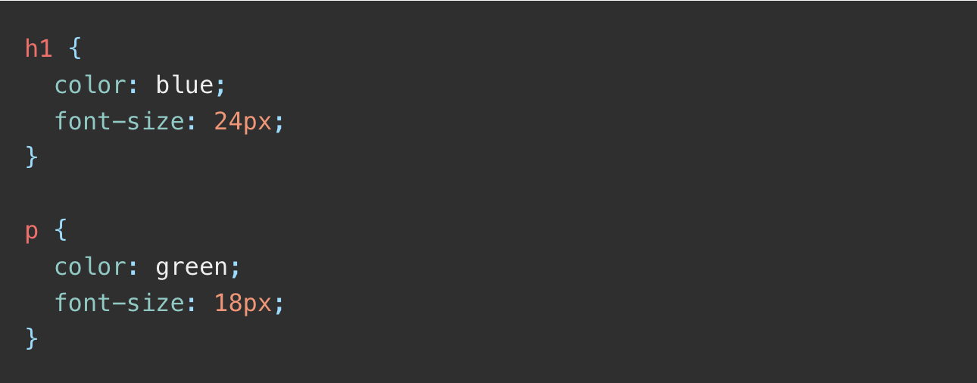
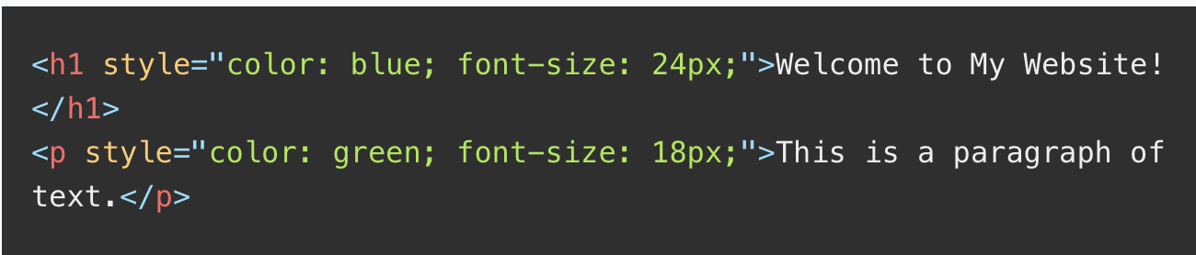
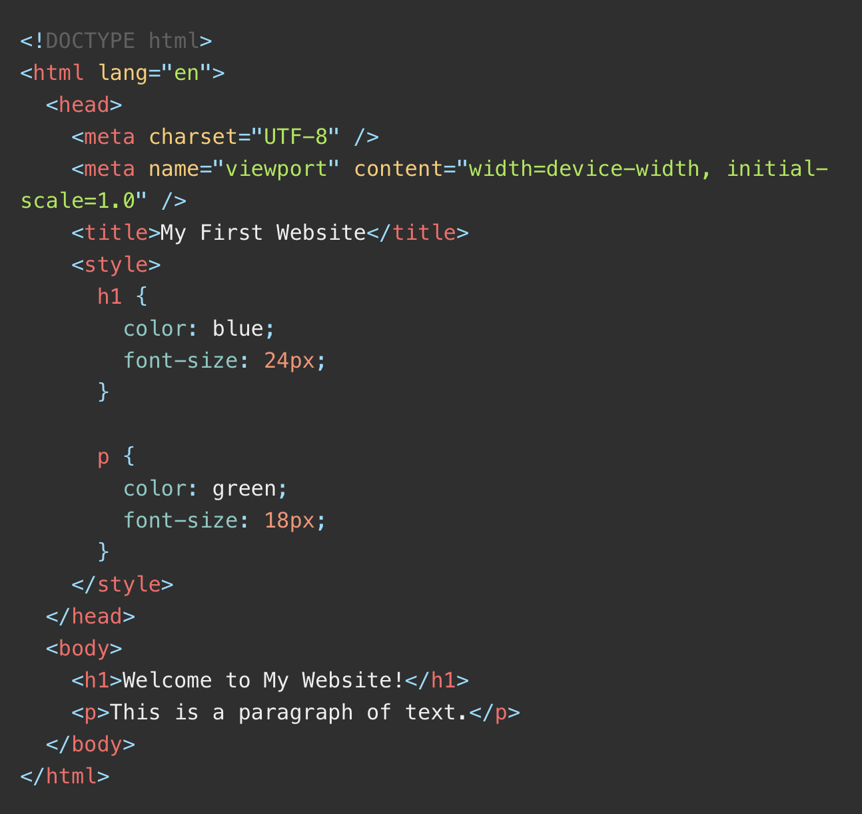
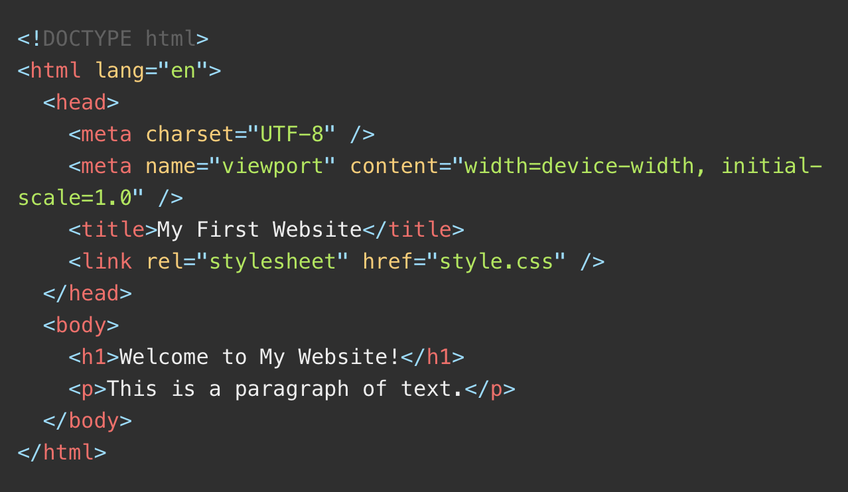
3 Levels of CSS Styling
Inline Styles
Internal Style
External Style
This is a .css file
This is a .html file

Slide 4
Let’s do some practice
Notes:
VSC Here
Change heading size
Change font color

Slide 5
CSS Selectors

Slide 6
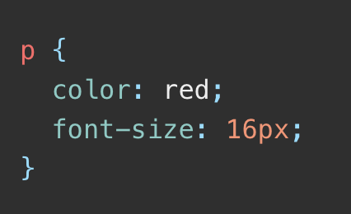
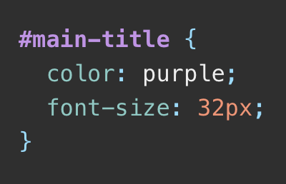
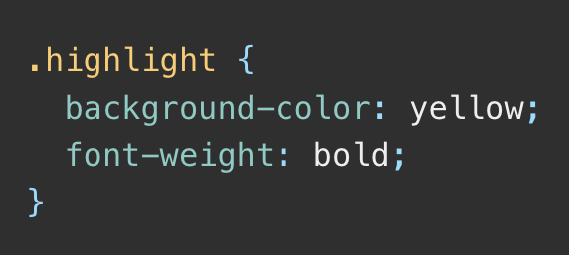
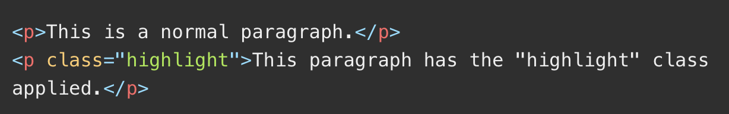

CSS (Actually, JS Too) Selectors
Once again, 3 types
Element (tag) Selectors
Class Selectors
ID Selectors
Notes:
Class selectos are better for group styling, ID selectors are better used for individual elements.

Slide 7
CSS Properties
A bit too many to list….
Well, here goes nothing.
color
background-color
border
margin
padding
font-size
line-height
font-family
display
z-index
…..you get the point.
Let’s practice a bit to see
the effects of each of them
Notes:
VSC Here

Slide 8
Div Containers
A bit of theory
Q1. What is it used for?
A1. The <div> tag in HTML is a container element used to group other HTML elements together.
Q2. Does it have any special meaning or semantic usages? Example: Like <h1>
A2. No, it is purely used based on just how the it is styled/scripted. Maximum customizability.
Q3. If you were to style different divs containers, what should you do?
A3. Use class or ID selectors.

Slide 9
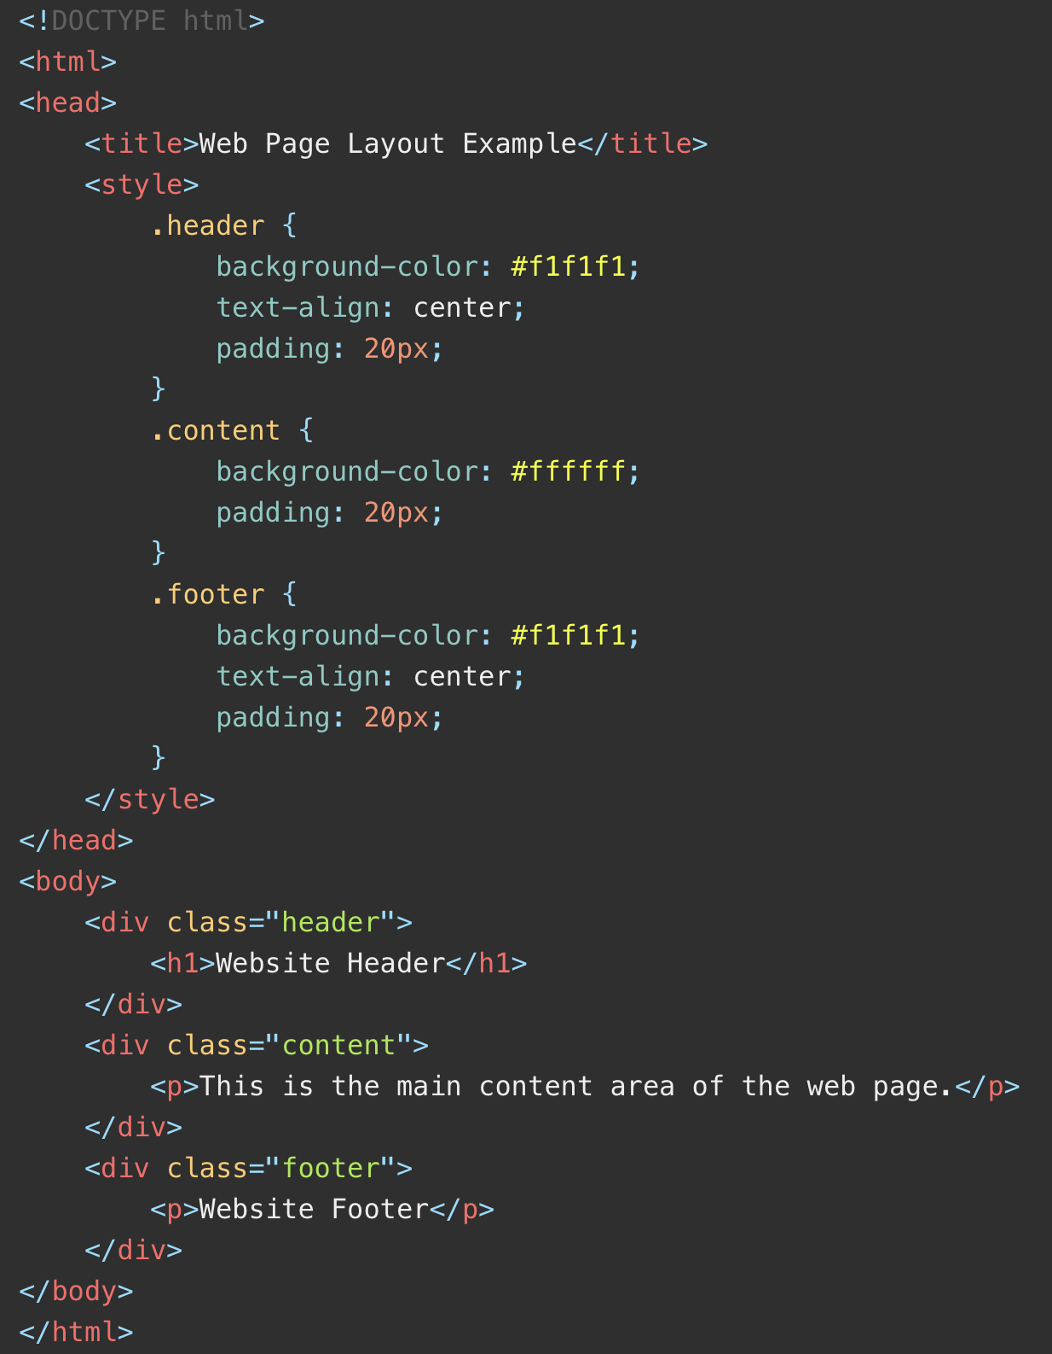
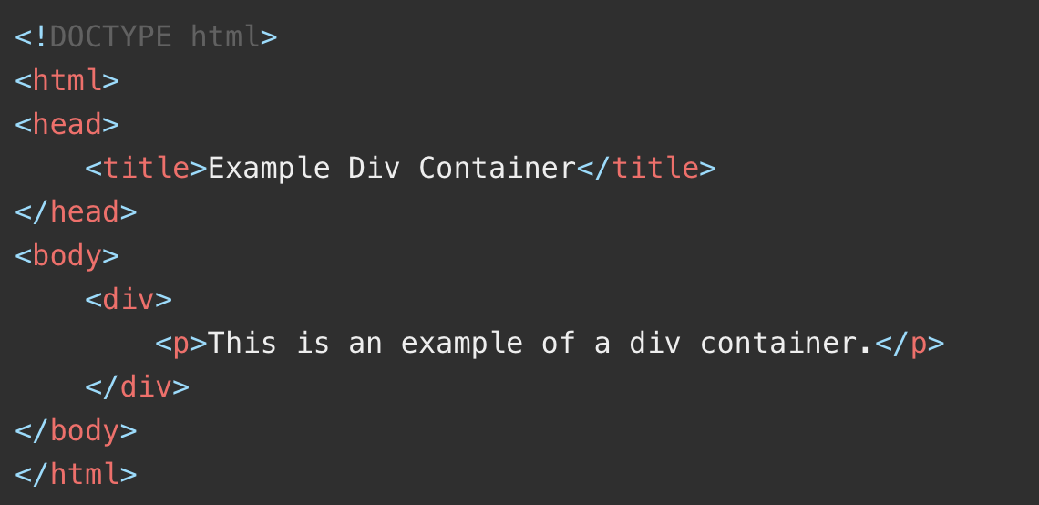
Div Containers
Practical
Try changing from class selector to ID selectors

Slide 10
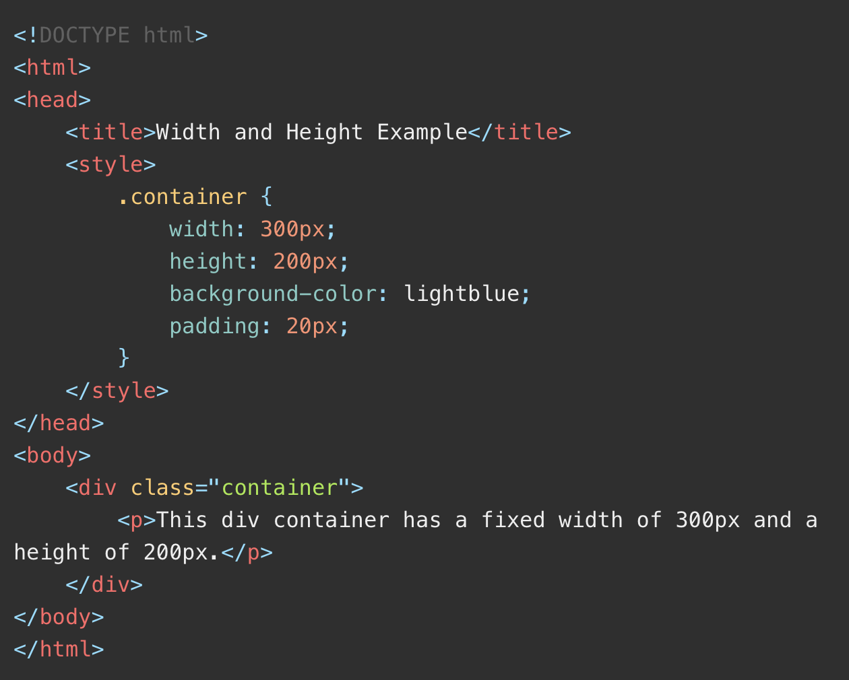
Width & Height
Pretty much self-explanatory

Slide 11
Measurement Units
Pixels (px)
Percentages (%)
em
rem

Slide 12
Measurement Units
Pixels (px)
Fixed unit of measurement representing a single point on a screen.
Percentages (%)
Relative to the size of the element parent’s container. Used for responsive designs
em
Relative to the font size of the element or its parent.
Eg. If font-size = 16px, 1em = 16px.
rem
Similar to em, but relative to ROOT element’s font size rather than
the element or its parent’s font size.

Slide 13
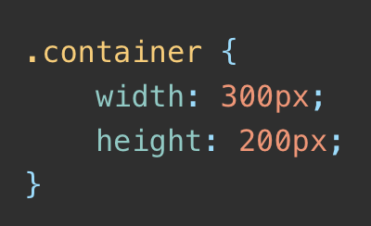
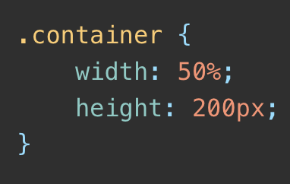
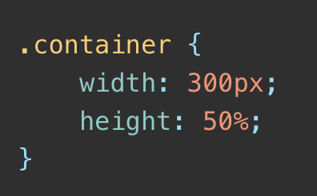
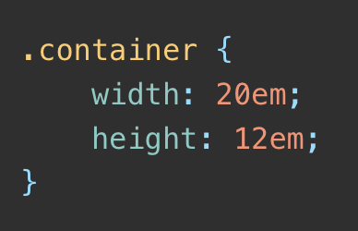
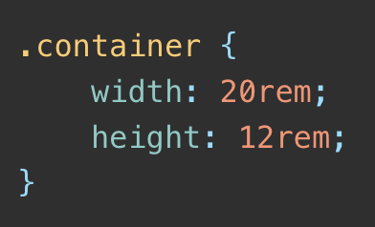
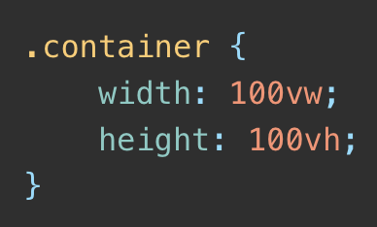
Measurement Units
Let’s try

Slide 14
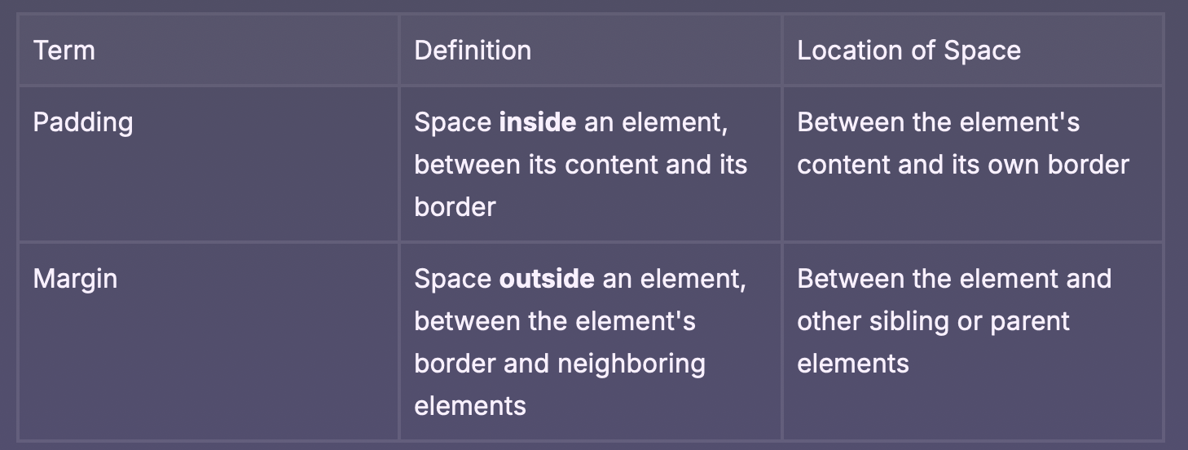
Padding vs Margin

Slide 15
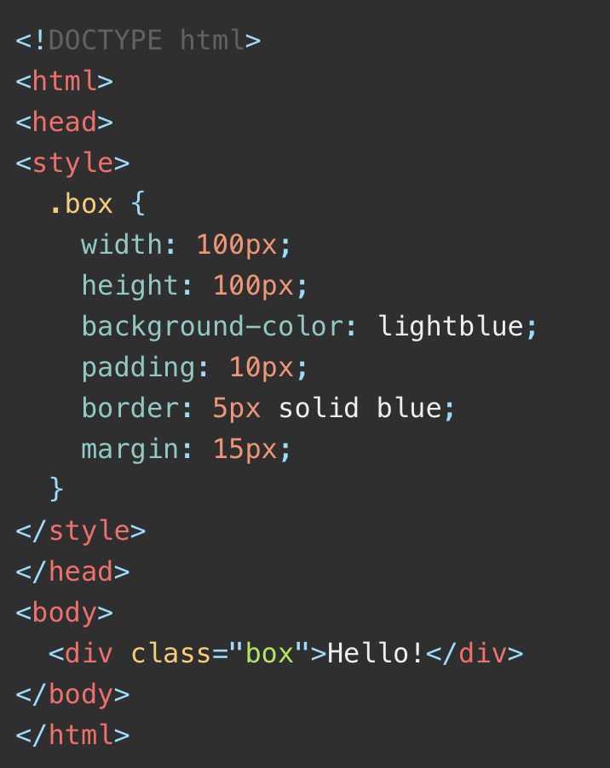
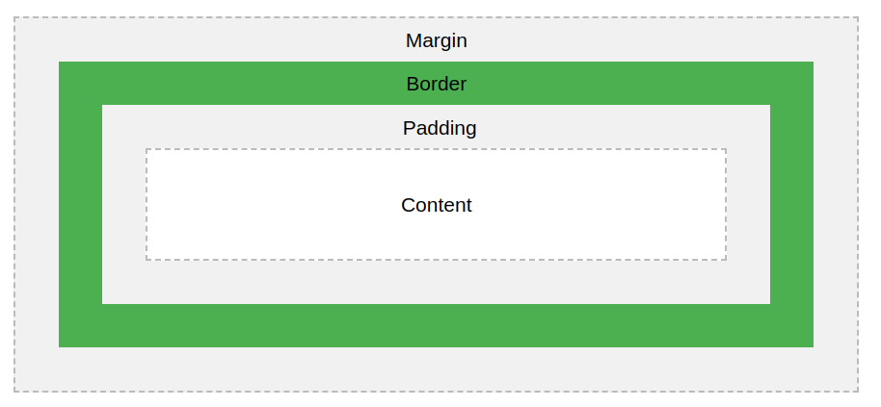
CSS Box Model
Notes:
VSC here

Slide 16
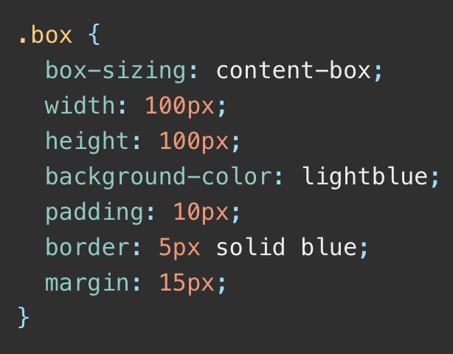
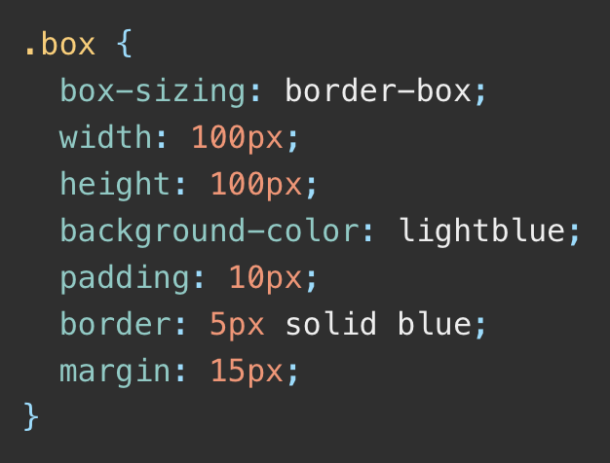
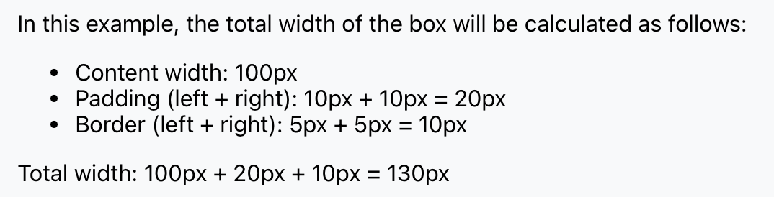
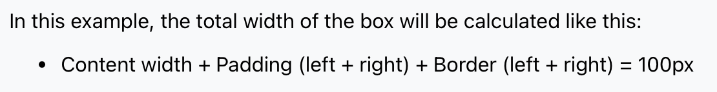
CSS Box Model
1. content-box
2. border-box
Only the content is used to determine width and height
The width and height declared is the entire element

Slide 17
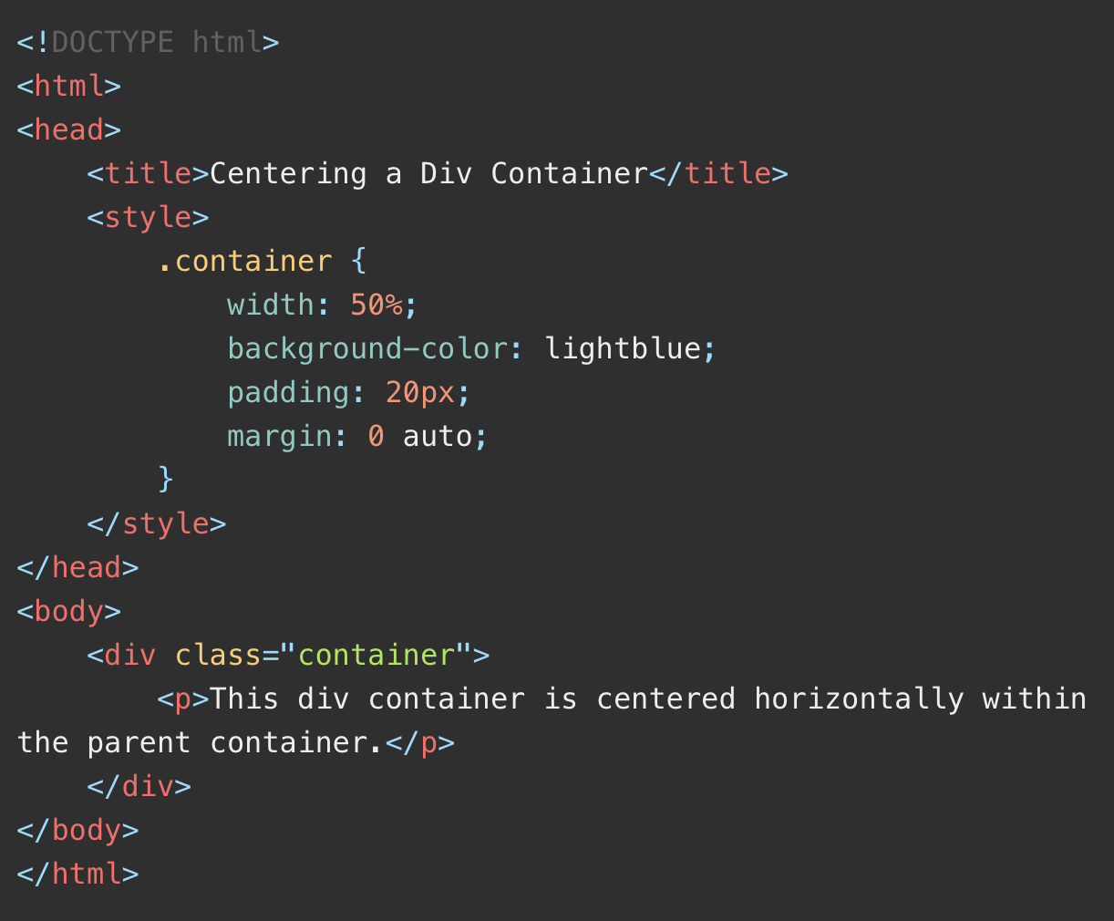
Centering elements
Use margin: auto;

Slide 18
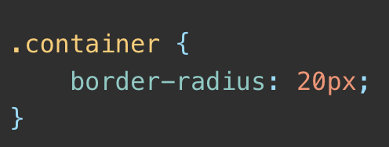
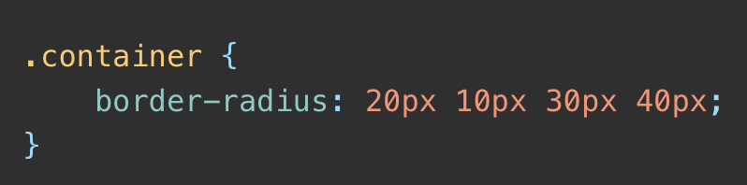
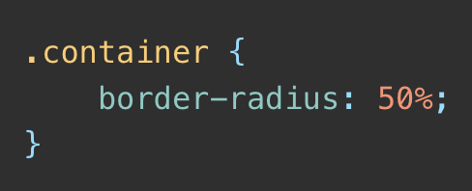
Rounded Corners
Creating Rounded Corners
Using border-radius
1. All corners
2. Individual corners
3. Percentage

Slide 19
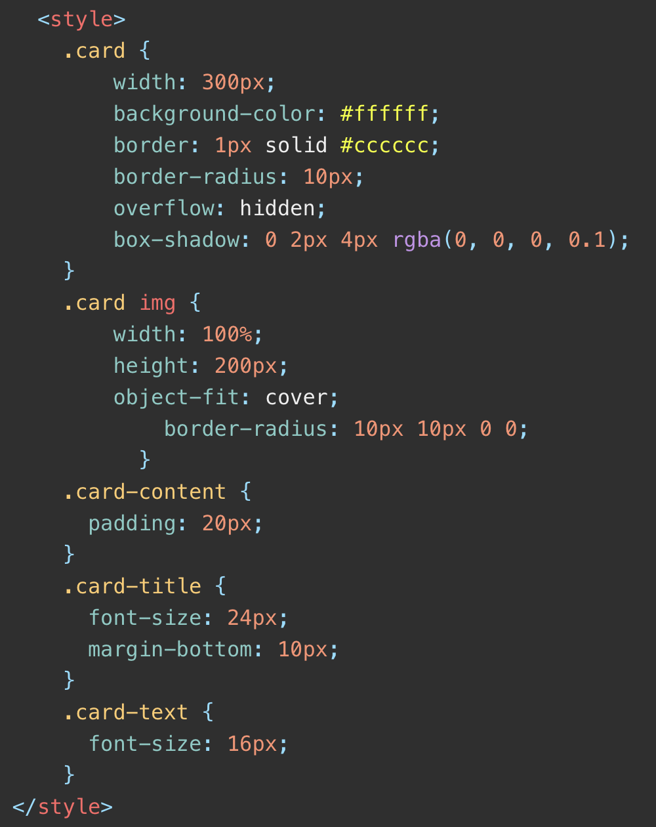
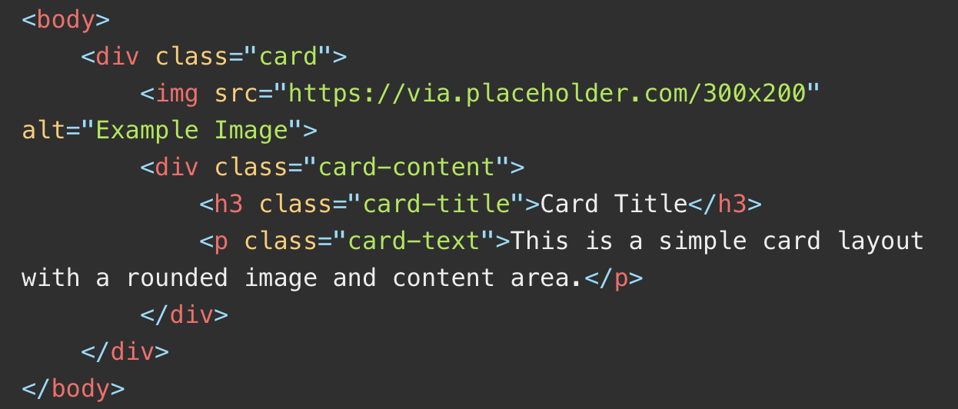
Rounded corners

Slide 20
CSS Positioning
X & Y Positioning
Relative Positioning
Absolute Positioning
Fixed Positioning
Sticky Positioning (New)
What happens when they’re on top of each other?
Z-index

